Slide 1
Non-linear models and analyzing results with R

Slide 2
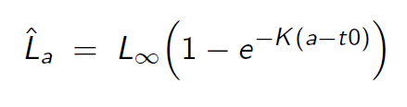
Von Bertalanffy growth
Start with “vonbert1.tpl” and “vonbert1.dat”
Save as “vonbert2.tpl” and “vonbert2.dat”
Calculate standard deviations of predicted length
Add REPORT_SECTION
Plot results in R with “vonbert.R”

Slide 3
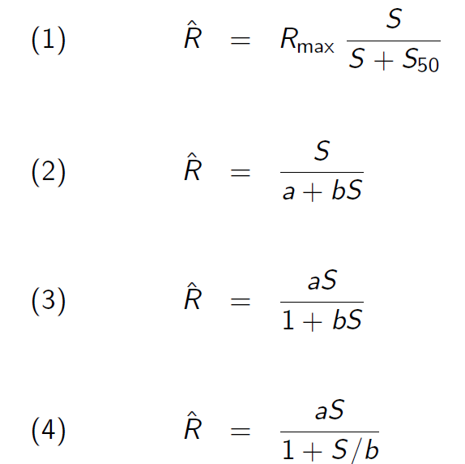
Beverton-Holt stock-recruit parameterizations
Run a few parameterizations of Beverton-Holt recruitment
Read results into single R script to compare in one figure
Repeat for Ricker curve and compare models

Slide 4
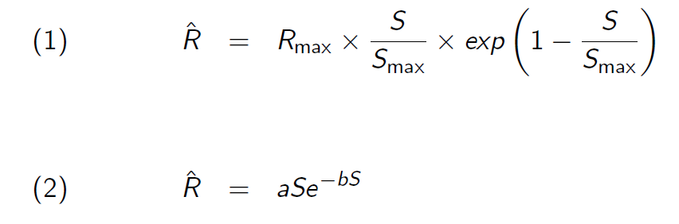
Ricker stock-recruit parameters

